Slide 1
SOFTWARE DEVELOPMENT LIFE CYCLE
(SDLC)

Slide 2
Introduction of SDLC
Learning Objectives:
Introduction of Software Process
PDCA Cycle
Phases in SDLC
SDLC Models
Waterfall Model
Incremental Model
Spiral Model
Agile Model

Slide 3
Software process
Process – Projects – Products
A software process specifies a method of
developing software.
A software project on the other hand, is a development project in which a software process is used.
A Software product is the final outcome of a
software project.

Slide 4
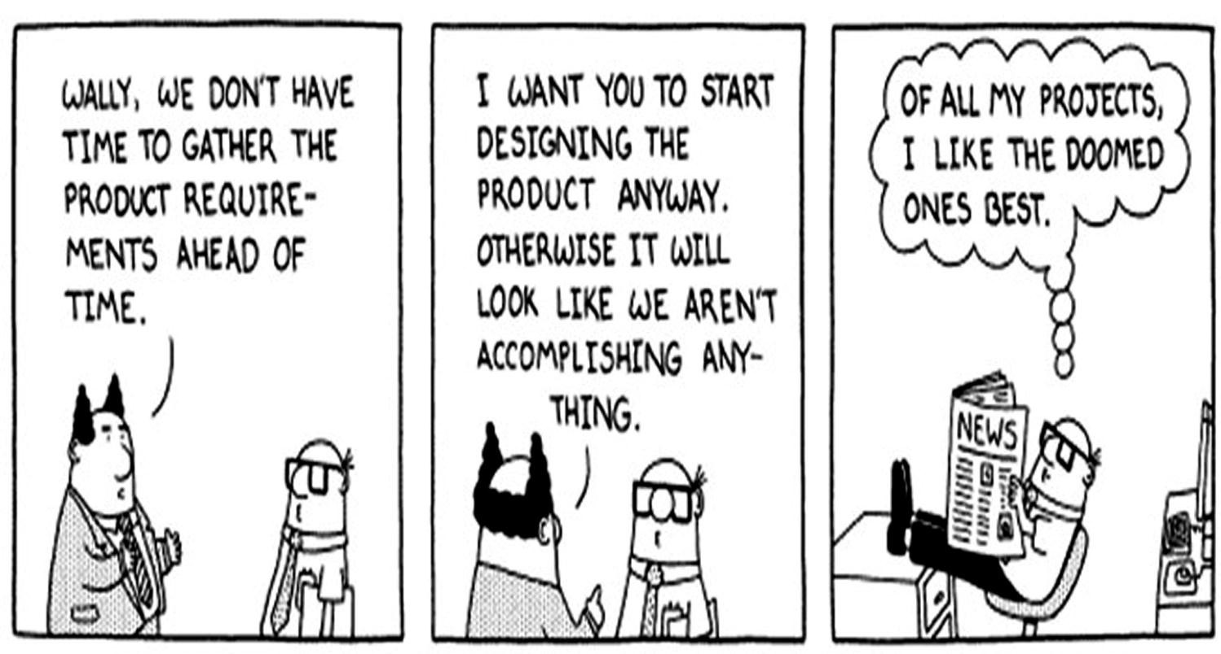
sdlc
Conclusion - Requirements are mandatory for any project to succeed.

Slide 5
Software development life cycle
Software Development Life Cycle(SDLC) is a process used by software industry to design, develop and test high quality software's.
The SDLC aims to produce a high quality software that meets or exceeds customer expectations, reaches completion within times and cost estimates.
The SDLC consists of a detailed plan describing how to develop, maintain, replace and alter or enhance specific software.
The life cycle defines a methodology for improving the quality of software and the overall development process.

Slide 6
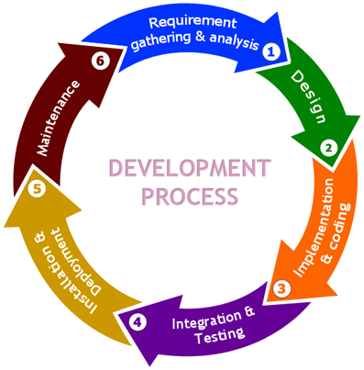
SDLC phases
req= customer req
Business req-
System req(srs)

Slide 7
Phases in sdlc
Stage 1: Requirement Gathering & Analysis
Business requirements are gathered in this phase.
It is performed by the senior members of the team with inputs from the customer, the sales department, market surveys and domain experts in the industry.
Meetings with managers, stake holders and users are held in order to determine the requirements
After gathering these requirements are analyzed for their validity and the possibility of incorporating the requirements in the system

Slide 8
Phases in sdlc
Based on the requirement analysis , Software Requirement Specification (SRS) document is created .
SRS consists of all the product requirements to be designed and developed during the project life cycle.
The testing team starts the Test Planning phase after the requirements analysis is completed.

Slide 9
Phases in sdlc
HLD-high level design
LLD-low level design
Stage 2 : Design
The outputs gathered in requirement phase are the
inputs of the design phase.
Based on the requirements specified in SRS, usually more than one design approach for the product architecture is proposed and documented in a DDS - Design Document Specification.
The DDS is reviewed by all the important
stakeholders.

Slide 10
Phases in sdlc
Stage 3 : Implementation & Coding
In this stage of SDLC the actual development starts and the product is built.
The programming code is generated as per
DDS during this stage.
Different high level programming languages such as C, C++, Pascal, Java, and PHP are used for coding.
The programming language is chosen with respect to the type of software being developed.

Slide 11
Phases in sdlc
Stage 4 : Integration & Testing
After the code is developed individually it is integrated into one project/product
It is then tested against the requirements to make sure that the product is actually solving the needs addressed and gathered during the requirements phase.
In this stage products defects are reported, tracked, fixed and retested, until the product reaches the quality standards defined in the SRS.

Slide 12
Phases in sdlc
Stage 5 : Deployment
After it passes the testing phase, the product is delivered/deployed to the customer for their use.
As soon as it is delivered, the customers first perform beta testing on the product.
If any changes are required or if any bugs are caught, then they report it to the engineering team.
Once those changes are made or the bugs are
fixed then the final deployment happens.

Slide 13
Phases in sdlc
Stage 6 : Maintenance
The software is maintained timely by updating the code according to the changes taking place in user end environment or technology.
Maintenance phase may face challenges from hidden bugs and real-world unidentified problems.

Slide 14
Models in sdlc
Following are the various SDLC Models :
Waterfall Model
Incremental Model
Spiral Model
Agile Model

Slide 15
Waterfall model
The Waterfall Model was first Process Model to
be introduced.
Waterfall model is the earliest SDLC approach
that was used for software development .
In a waterfall model, each phase must be completed before the next phase can begin and there is no overlapping in the phases.
In waterfall model ,phases do not overlap.

Slide 16
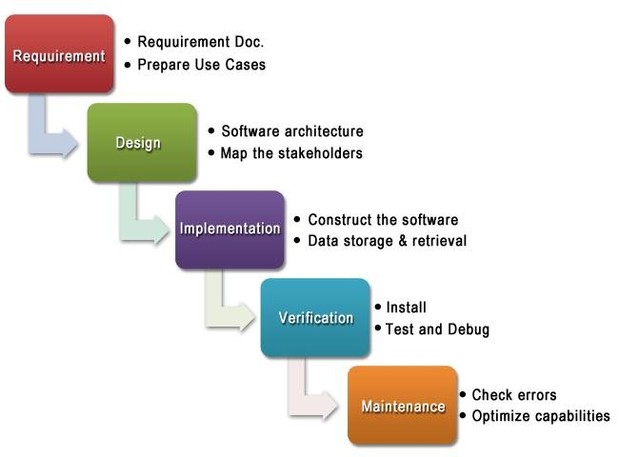
Waterfall model

Slide 17
Phases in waterfall model
Requirement Analysis
Requirements are a set of functions and constraints that the end user expects from the system.
The requirements are gathered from the end user, and are analyzed for their validity and the possibility of incorporating them.
Design
The design helps in specifying hardware and system requirements, and also helps in defining the overall system architecture.
The system design specifications serve as an
input for the next phase of the model.

Slide 18
Phases in waterfall model
Implementation
On receiving system design documents, the work is
divided in modules/units and actual coding starts.
The system is first elaborated into small programs
called units, which are integrated in the next phase.
Verification/Testing
Each unit is developed and tested for its functionality; this is referred to as unit testing.
Unit testing mainly verifies if the modules/units meet
their specifications.
Maintenance
This phase of the model is virtually never-ending.
The problems do not come into picture directly, but
they arise from time to time and need to be solved.

Slide 19
Each phase is an output
Phase
Requirements analysis
Output
Software Requirements Specification (SRS), Use Cases
Design Document,
Design Classes
Design
Implementation Test
Code
Test Report, Change Requests

Slide 20
Advantages of waterfall model
This model is simple and easy to understand and
use.
It is easy to manage due to the rigidity of the model
– each phase has specific deliverables and a review process.
In this model phases are processed and completed one at a time. Phases do not overlap.
Waterfall model works well for smaller projects
where requirements are very well understood.

Slide 21
Disadvantages of waterfall model
Once an application is in the testing stage, it is very difficult to go back and change something that was not well-thought out in the concept stage.
No working software is produced until late during the life cycle.
High amounts of risk and uncertainty.
Not a good model for complex and object-oriented
projects.
Poor model for long and ongoing projects.
Not suitable for the projects where requirements are at a moderate to high risk of changing.

Slide 22
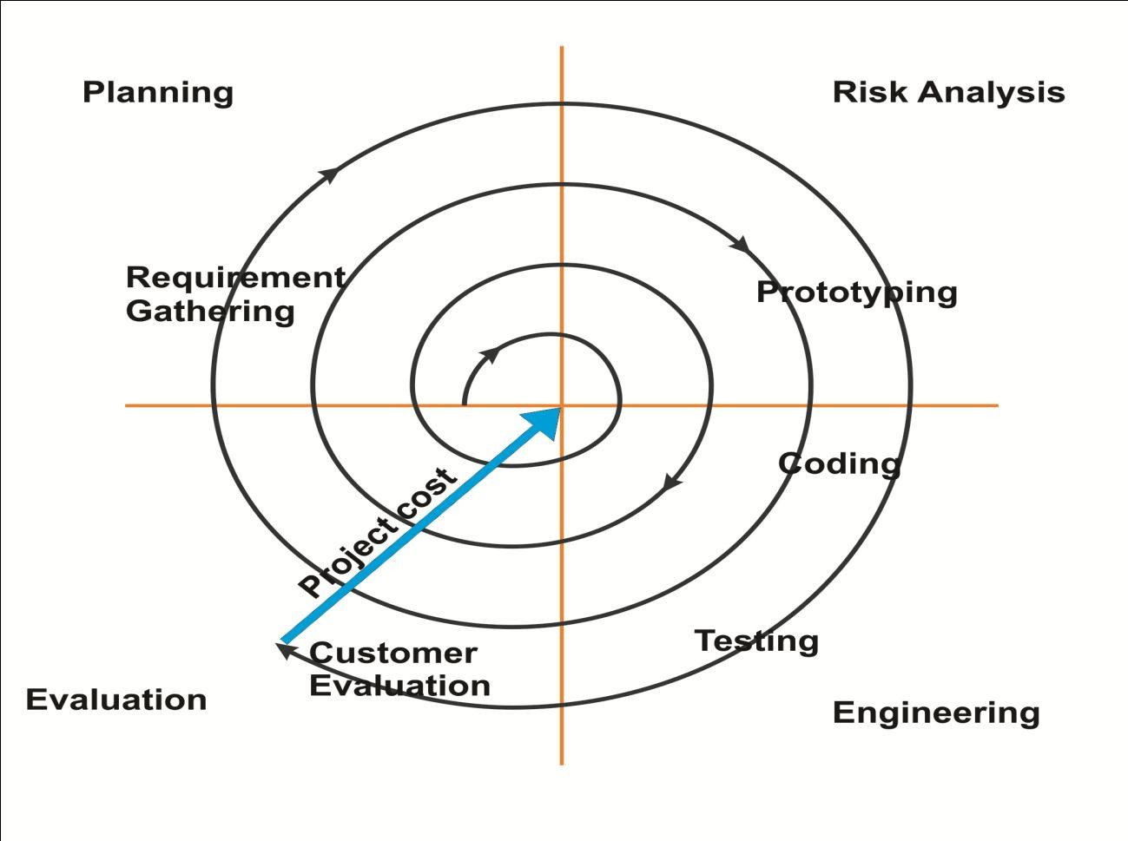
Spiral model
Planning
Risk Analysis
Evaluation
Engineering

Slide 23
Spiral model phases
Planning Phase: Requirements are gathered during the planning phase.
Risk Analysis: Identifies risk and alternate solutions. A prototype is produced at the end of the risk analysis phase. If a risk is found during the risk analysis then alternate solutions are suggested and implemented.
Engineering Phase: In this phase software
is developed, along with testing at the end of the
phase.
Evaluation phase: This phase allows the customer to evaluate the output of the project till date before the project continues to the next spiral.

Slide 24
Spiral sdlc model
In a Spiral model the software is developed in a series of incremental releases.
There is a Focus on Risk analysis
Combines the features of the prototyping
model and the waterfall model.
In order to overcome the constraints of "The
Waterfall Model", Spiral Model was developed.
The fact that the process needs to be iterated more than once demands more time and is somehow expensive task.
This Model is used in large, expensive and complicated projects.

Slide 25
Spiral model advantages
High amount of risk analysis.
Good for large and mission critical projects.
Software is produced early in the SDLC.

Slide 26
Spiral model disadvantages
Can be costly model to use.
Risk analysis requires highly specific
expertise.
Project success is highly dependent on the
risk analysis phase.
Don’t work well for smaller projects.

Slide 27
When to use spiral model
When creation of a prototype is appropriate
When costs and risk evaluation is important
For medium to high-risk projects
Users are unsure of their needs
Requirements are complex
Significant changes are expected.

Slide 28
Incremental model
In incremental model the whole requirement is divided into various builds.
Cycles are divided up into smaller, more easily managed modules.
Each module passes through the requirements, design, implementation and testing phases.
Each subsequent release of the module adds
function to the previous release.
The process continues till the complete system is
achieved.

Slide 29
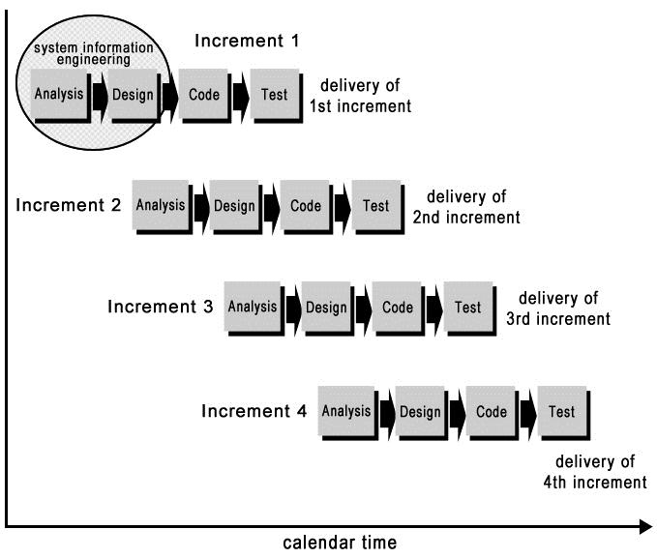
Incremental model

Slide 30
Advantages of Incremental model
Generates working software quickly and early
during the software life cycle.
This model is more flexible – less costly to
change scope and requirements.
It is easier to test and debug during a smaller
iteration.
In this model customer can respond to each
built.
Lowers initial delivery cost.
Easier to manage risk because risky pieces are
identified and handled during it’d iteration.

Slide 31
Disadvantages of Incremental model
Needs good planning and design.
Needs a clear and complete definition of the whole system before it can be broken down and built incrementally.
Total cost is higher than waterfall.

Slide 32
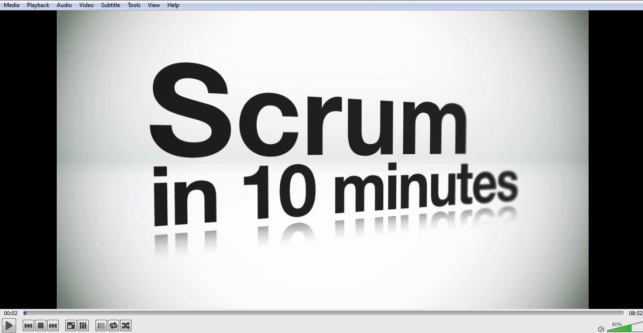
Agile Development
Play Agile Scrum Video for students

Slide 33
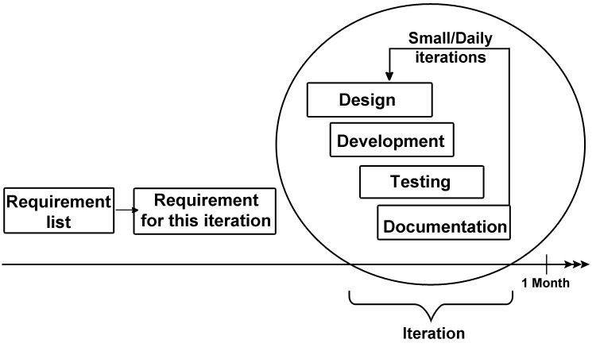
Agile model

Slide 34
Agile model
Agile development model is also a type of Incremental model.
Software is developed in incremental, rapid
cycles.
This results in small incremental releases with each release building on previous functionality.
Each release is thoroughly tested to ensure software quality is maintained.
It is used for time critical applications.

Slide 35
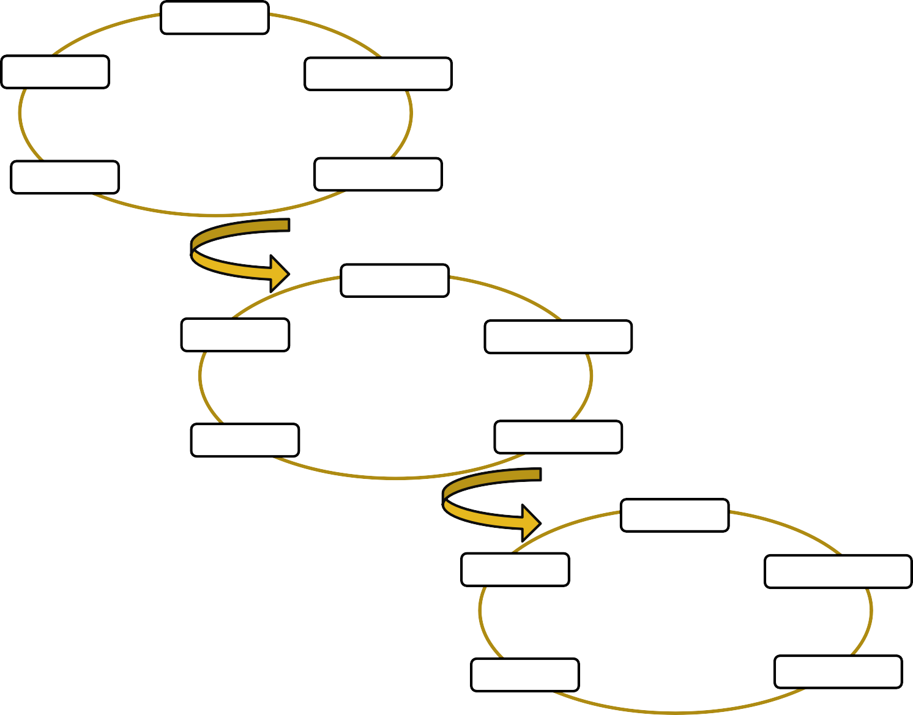
Agile model
Testing
Req Analysis
Iteration 1
Building
Designing
2-3 Month
Planning
Testing
Req Analysis
Iteration 2
Building
Designing
2-3 Month
Planning
Testing
Req Analysis
Iteration 3
Building
Designing

Slide 36
Advantages of agile model
Advantages of Agile model
People and interactions are emphasized rather than process and tools.
Customers, developers and testers constantly
interact with each other.
Working software is delivered frequently
(weeks rather than months).
Continuous attention to technical excellence
and good design.
Regular adaptation to changing circumstances. Even late changes in requirements are welcomed.

Slide 37
Disadvantage of agile model
In case of some software deliverables, especially the large ones, it is difficult to assess the effort required at the beginning of the software development life cycle.
There is lack of emphasis on necessary
designing and documentation.
The project can easily get taken off track if the customer representative is not clear what final outcome that they want.
Only senior programmers are capable of taking the kind of decisions required during the development process.

Slide 38
Scrum and sprint
Scrum, the most popular agile framework in software development, is an iterative approach that has at its core the sprint — the scrum term for iteration.
Scrum teams use inspection throughout an agile project to ensure that the team meets the goals of each part of the process.
Each sprint is divided into its own list of requirements.
Within each sprint, the development team builds and tests a functional part of the product until the product owner accepts it and the functionality becomes a potentially shippable product.
Scrum teams deliver product features in increments at
the end of each sprint.
A product release occurs at the end of a sprint or after several sprints.

Slide 39
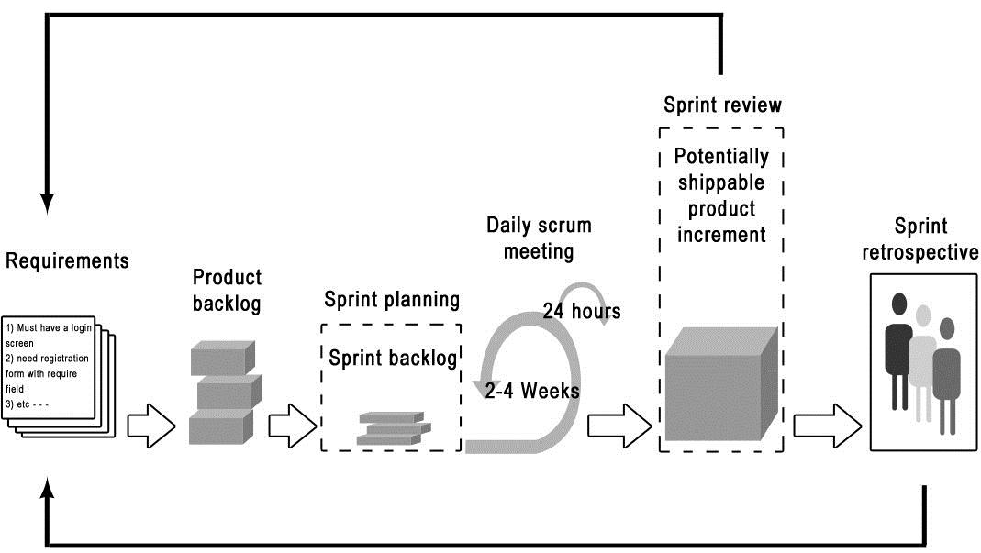
Function of sprint product backlog

Slide 40
Interview Questions
What are different phases in SDLC?
What are the strength of waterfall model?
When to use spiral model?
What are advantages of Incremental Model?
What is the weakness of Agile Model?
What is Scrum Methodology used in Agile Software Development ?
What is the difference between BRS and SRS ?

Slide 41

Any Questions?

